Slide 1
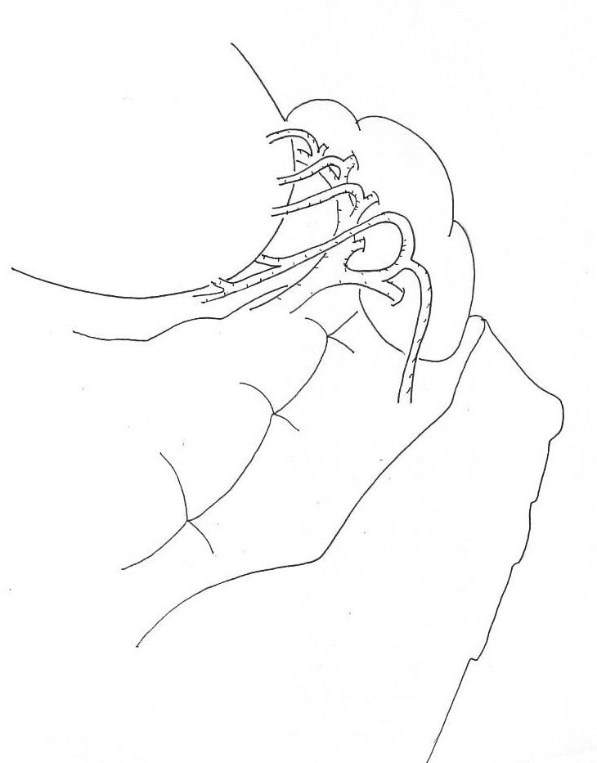
left gastroepiploic a
4sb
epiploic a

Slide 2
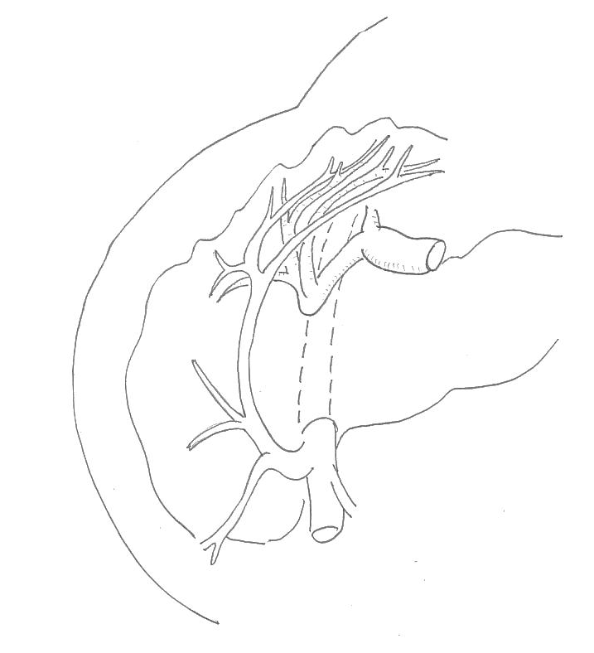
infra pyloric a
infra pyloric v
R gastroepiploic a
ASPDV
R gastroepiploic v
VCDA
VCM

Slide 3
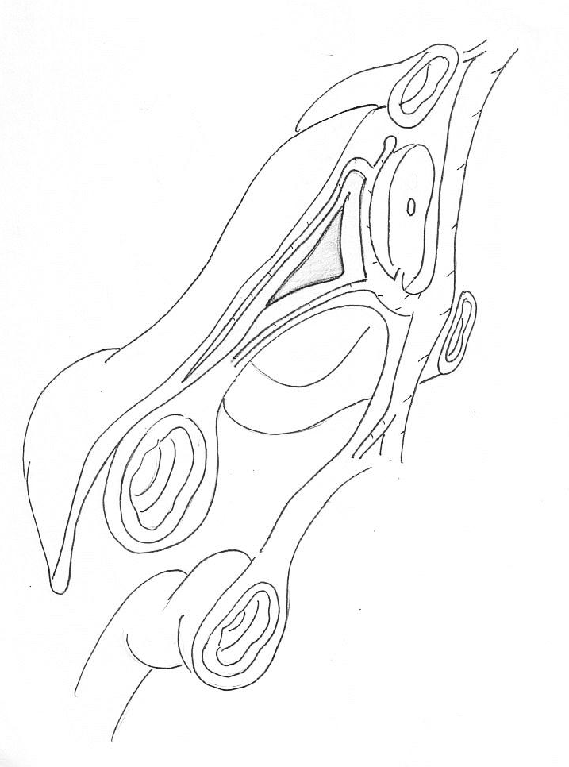
SMV
fusion fascia
R gastroepiploic v
ASPDV
omentum
GCT
VCDA

Slide 4
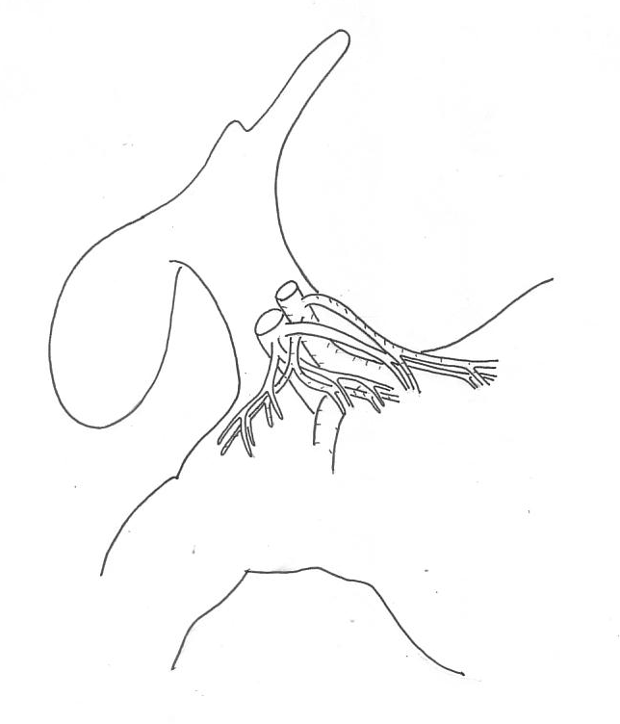
R gastric a.v
supraduodenal a.v

Slide 5
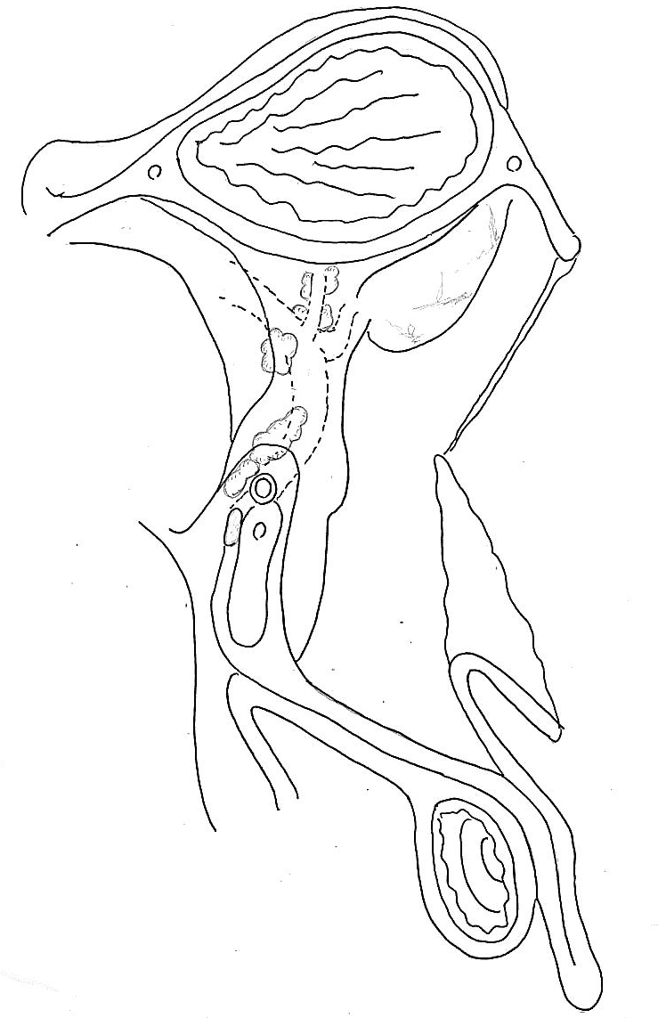
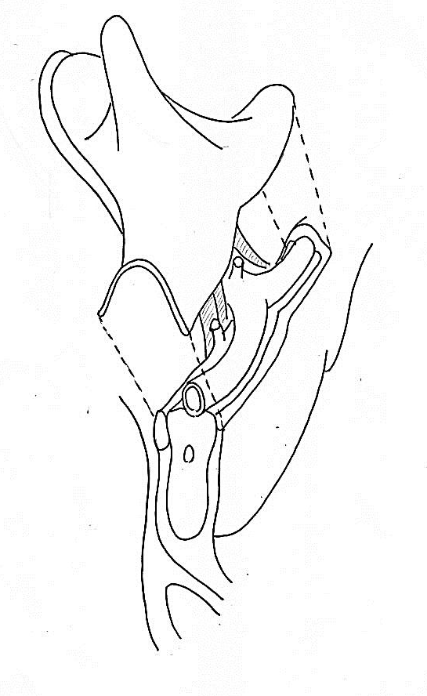
無漿膜野
膵後筋膜
Toldt
Gerota
大動脈脚
網嚢
膵被膜
膵前筋膜
膵後筋膜
Tritz
Gerota

Slide 6
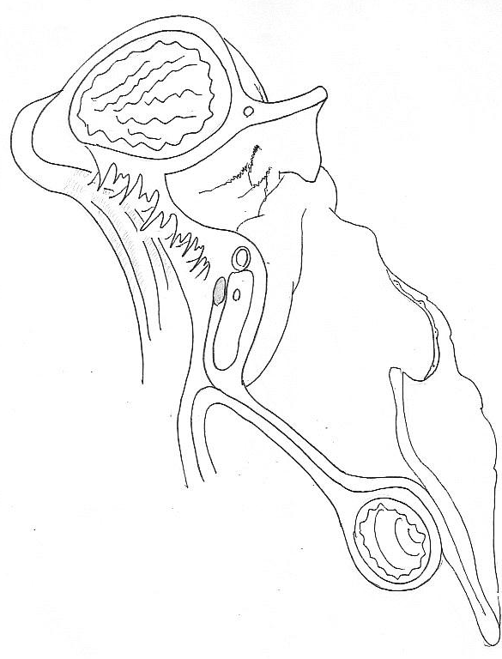
膵被膜
膵前筋膜
ＳＡ
ＳＶ
胃膵間膜左

Slide 7
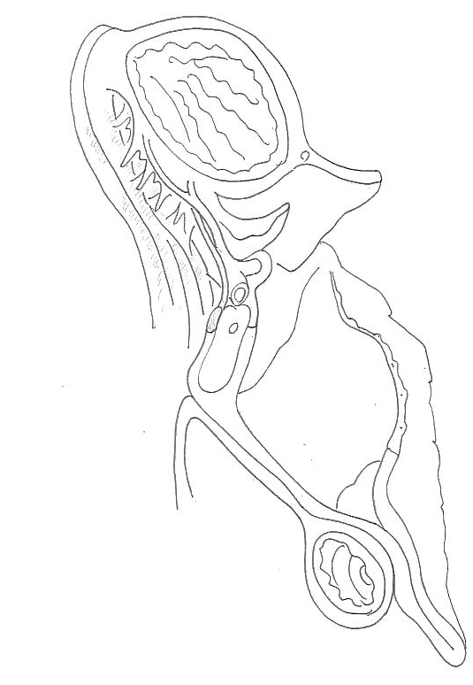
無漿膜野
大動脈脚
LGA
LGV

